Slide 1

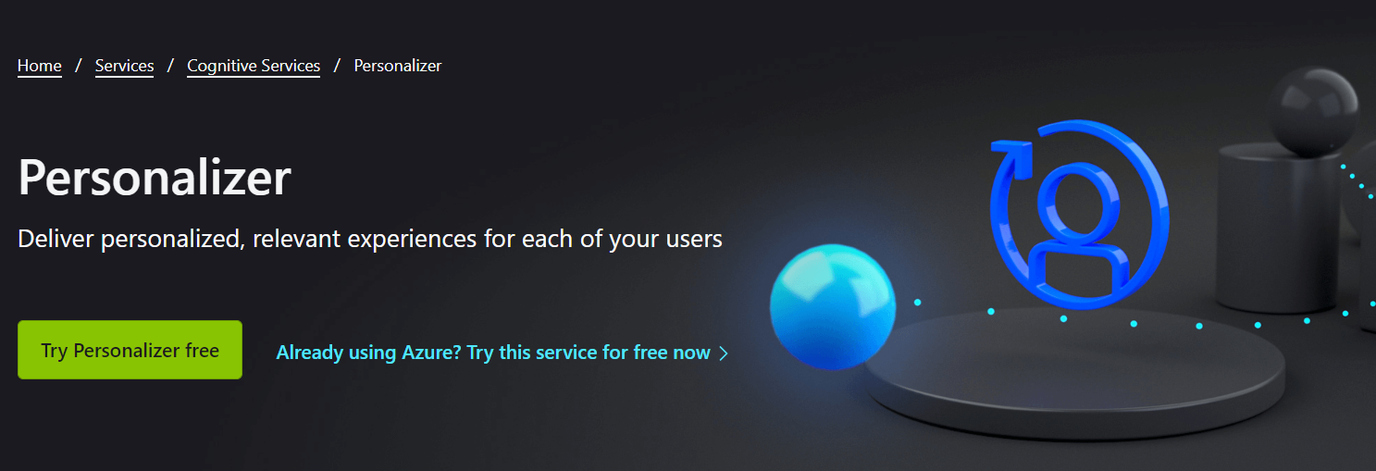
VW 9.2 & Personalizer upgrades
ICML 2022 Expo Day 7/17
VW contributors & APS team

Slide 2
What is Vowpal Wabbit?
Open Source
Online learning
Interactive Reinforcement
What is Azure Personalizer Service?
+High availability
+Perfect logging
+Reporting
+…

Slide 3
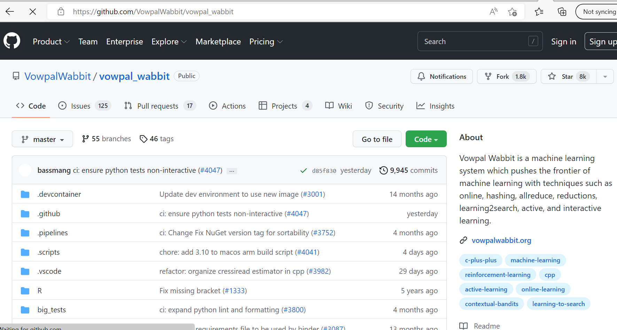
Open Source: Tweak, improve, play. BSD License

Slide 4
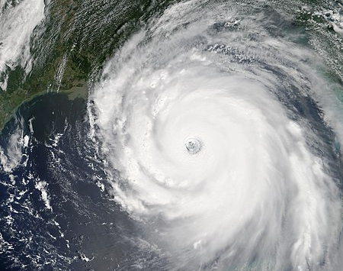
Online Learning: Adapt!
Progressive Validation
Rapid Adaptation
Sublinear debug

Slide 5

Interactive Reinforcement
Single Sample Update
Natural Feedback
+Active Learning
Action
Policy ?
Observation
Reward

Slide 6
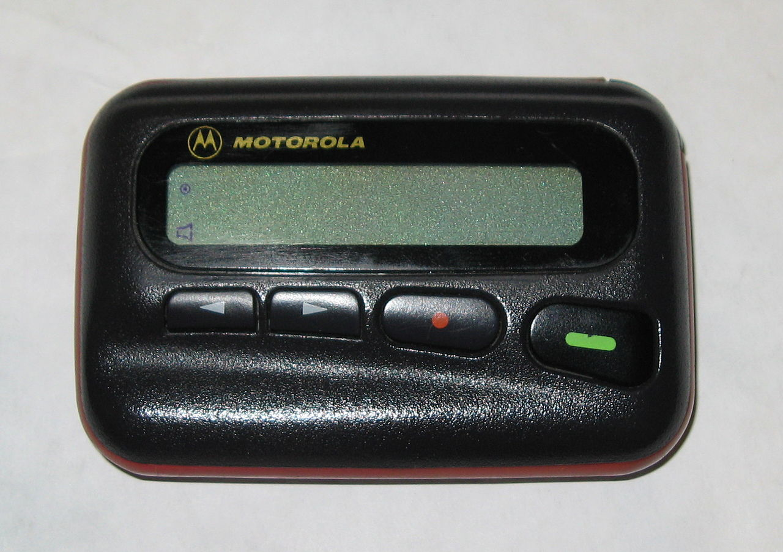
High Availability: Who wears the beeper?

Slide 7
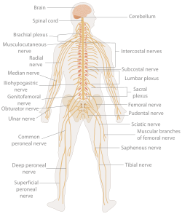
Logging: Always get the right data to learn from

Slide 8
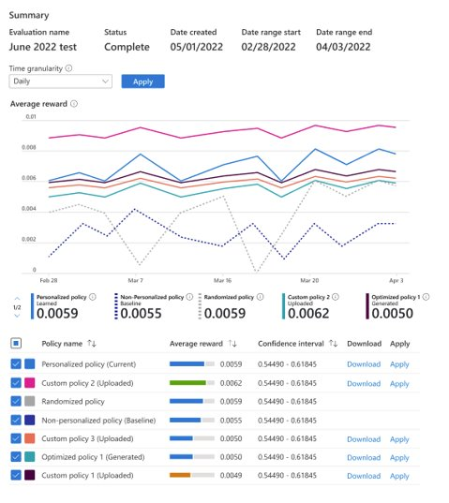
Reporting: What’s going on?

Slide 9
The plan for the day

